Slide 1
LINKEDIN
Notes:
This presentation is about “Linkedin”

Slide 2

1. LinkedIn -What is it & Why use it?
In today's busy and connected world, branding yourself and connecting with other professionals has never been more important.
One of the best platforms for doing this is LinkedIn

Slide 3

1. LinkedIn -What is it & Why use it?
Over 690 million professionals in more than 200 countries use LinkedIn to connect, exchange information, ideas & opportunities!!
Virtual Resume
Create an Internet Presence
Business Social Networking
Connection referrals
Research Individual or Company
Find Employment Opportunities
Network, Network, Network!!!
Notes:
Leaders are more important as expected.

Slide 4

1. LinkedIn -What is it & Why use it?
What’s Your Purpose
Job seeking
Building a professional network
Showcasing a product or service
Searching for content

Slide 5
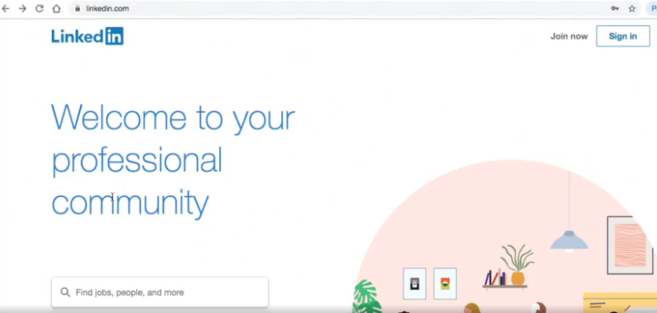
2. How to set up Linkedin profile
https://www.linkedin.com

Slide 6
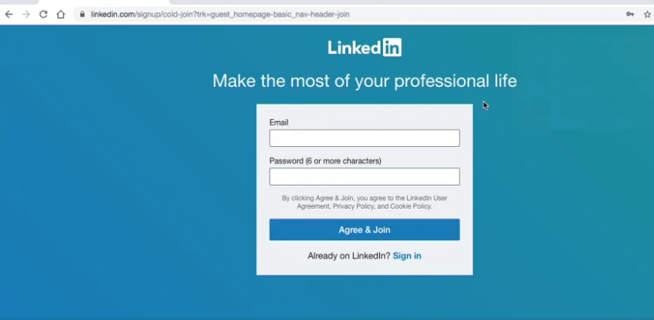
3. Sign up

Slide 7
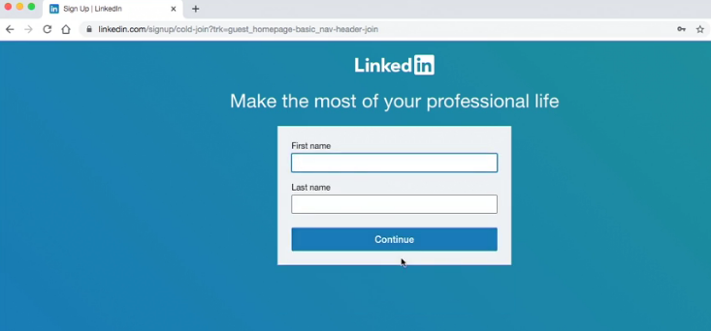
4. Enter Name & Surname

Slide 8
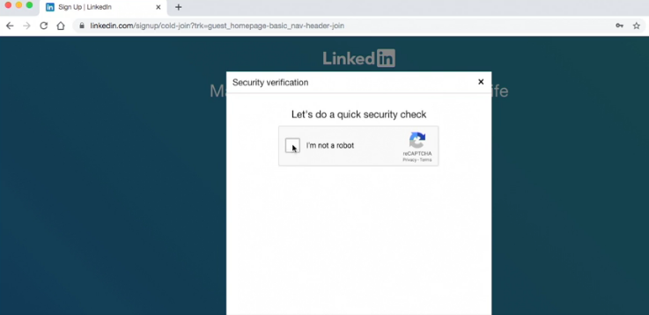
5. Click “I’m not a robot”

Slide 9
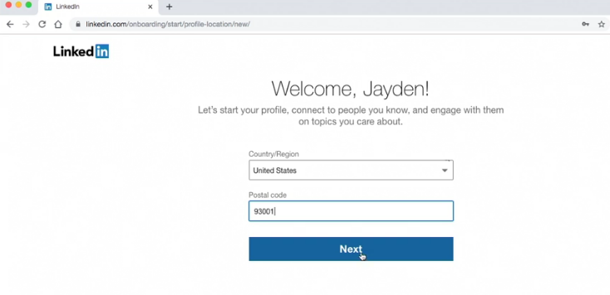
6. Select “Country/Region”

Slide 10
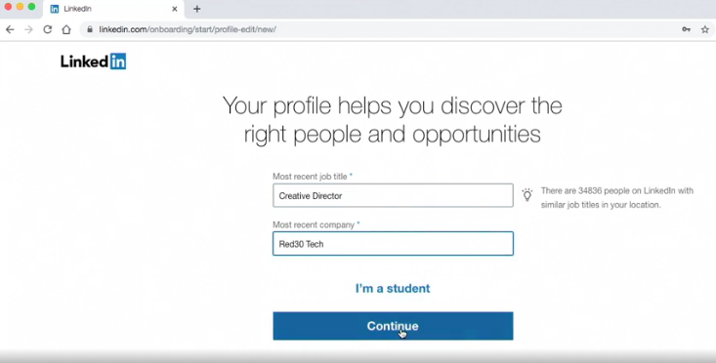
7. Select “Job title”

Slide 11
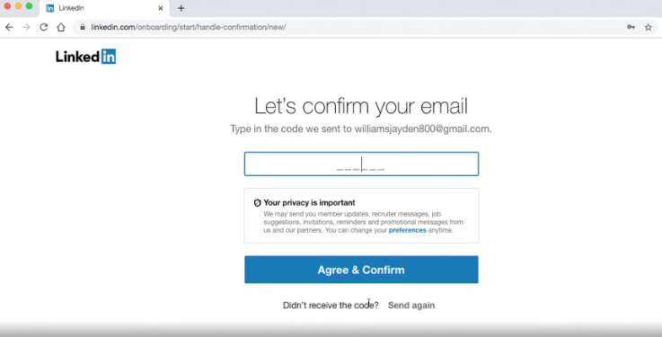
8. Confirm e-mail

Slide 12
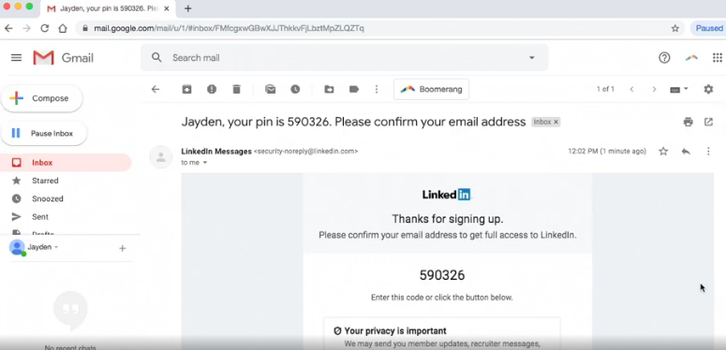
9. Check e-mail

Slide 13
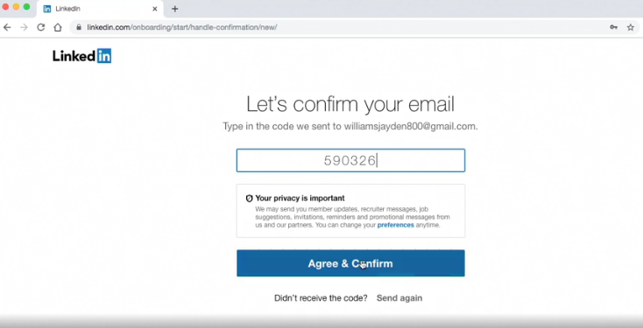
10. Confirm e-mail

Slide 14
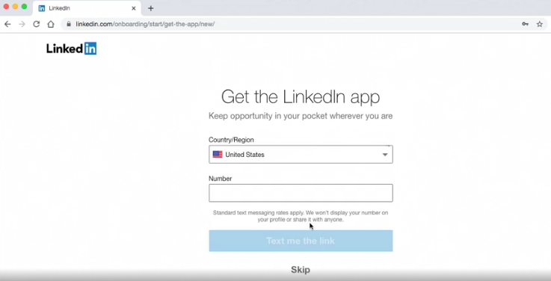
11. Get the Linkedin app

Slide 15
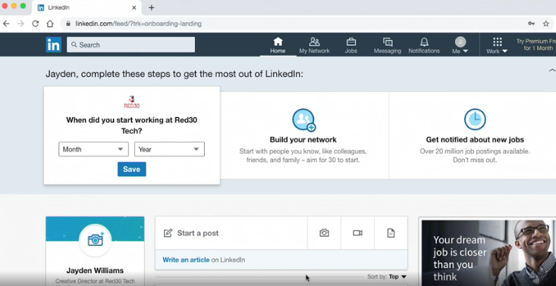
12. Linkedin Home Page

Slide 16

13. Be Visible
Add quality information
Use keywords
Create value for your network
Stay active

Slide 17

14. Some Advice
Be professional
Keep your profile up-to-date
Be yourself, be honest
Share your profile

